Slide 1
Entanglement, Bell States, and Multi-Qubit Systems

Slide 2
Objectives
Illustrate how multi-Qubit Systems work
The Role of the CNOT gate (operator)
Understand How Entanglement Works
Be familiar with Quantum circuits
Introduce quantum gates (operators) and explain their roles

Slide 3
Initializing Using Hadamard
A remarkable property of H is that it creates a superposition state out of either |0⟩ or |1⟩.
Creating superpositions from basis states is of great practical value, because quantum computing hardware usually encourages intituling qubits to |0⟩.
Running those qubits through an H gate turns each |0⟩ into a |+⟩, which is an equal superposition of |0⟩ and |1⟩.
Putting each of our input qubits into superposition is the key step that enables many of the other useful properties of quantum computing.

Slide 4
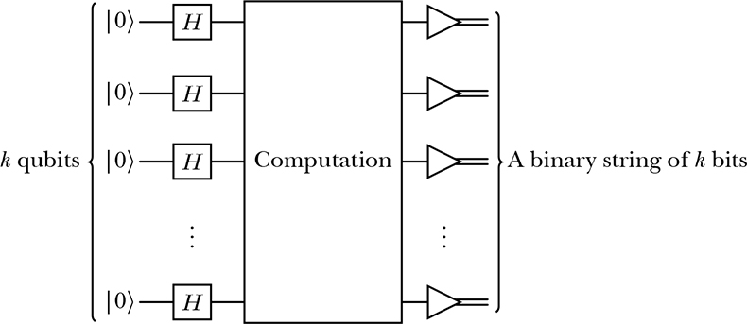
Most Algorithms Initialize qubits to |0> then go into H
As a result, many quantum algorithms begin with a bunch of qubits initialized to |0⟩, which immediately go into H gates. Then we do some computing and finally measure the qubits. The Figure Below shows this common architecture using k qubits.

Slide 5
Quantum Entanglement
As per our previous definition of entanglement:
Quantum entanglement is a phenomenon in quantum physics where two or more particles become connected in such a way that the state of one particle instantly influences the state of the other, no matter how far apart they are.
Key Points:
Connection Beyond Distance: If two particles are entangled, measuring a property (like spin or polarization) of one particle immediately determines the corresponding property of the other, even if they are light-years apart.
Shared Quantum State: Entangled particles share a single quantum state. They cannot be described independently; their properties are linked.
Counterintuitive Behavior: This seems to violate common sense, because the effect is instantaneous. However, it does not allow faster-than-light communication, but it does challenge classical ideas of locality.

Slide 6



The CNOT Gate (The XNOT gate)
As we are going to see in a while, Entanglement is implemented using the two-qubit
In the first two diagrams, the first qubit in the control gate, while the lower is the target gate
In the third diagram, the lower qubit is the control gate, while the upper is the target
We have seen the unitary representation of the X gate before
Here the CNOT gate flips the output of the target qubit if the state of the first qubit is |0>, other wise it leaves the state of the target qubit s is

Slide 7
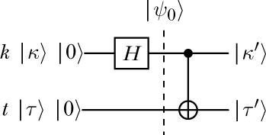
Circuit Implementation of Entanglement
As apparent from the diagram below, Entanglement is implemented using the Hadamard gate, followed by the cross-qubit CNOT Gate
The Hadamard gate puts the first qubit in superposition mode, while the CNOT gate controls the output of the second qubit to provide a shared entanglement state

Slide 8


Important Note: Two-qubit states are tensor products of the individual qubit states
The tensor product of two one-qubit states always yields a two-qubit state.
Such states, which can be decomposed as the tensor product of other states, are said to be product states. For example, |00⟩ is a product state because its just a shortened way of writing |0⟩⊗|0⟩.
Likewise, the following state is also a product state
is also a product state, because it is equal to |+ ⟩|+ ⟩.
Similarly, the state below is a product state
which is the same state as |0⟩|+ ⟩.
One Exception is the Entanglement State: cannot be obtained as a product state

Slide 9
The CNOT Gate
The CNOT, controlled-NOT, or controlled-X gate is a two-qubit gate that cannot be obtained as the tensor product of two one-qubit gates.
Its name is derived from the way it acts on the computational basis, which is the following:
CNOT |00⟩ = |00⟩,
CNOT |01⟩ = |01⟩,
CNOT |10⟩ = |11⟩,
CNOT |11⟩ = |10⟩.
As can be observed, the value of the second qubit is reversed (or negated) if and only if the value of the first qubit is 1.
In this way, we can say that the first qubit controls whether an X (also called NOT) gate is applied to the second qubit or not, hence the name of the operation.
Usually, the first qubit is called the control qubit and the second one is called the target qubit. The action on non-basis states is obtained by linearity. Indeed, we have that

Slide 10


Compute the components of the input state |+0⟩ at |ψ₀⟩
Compute the input state |+0⟩ at |ψ₀⟩
noting that $V=1/{\sqrt{2}}$
We compute the state at point |ψ₀⟩ in the diagram below:
$$\left|\left.ψ_{0}\right\rangle \right.=\left|+0\right\rangle =\left|+\right\rangle ⊗\left|0\right\rangle =∨\left[\begin{matrix}1 \\ 1\end{matrix}\right]⊗\left[\begin{matrix}1 \\ 0\end{matrix}\right]=∨\left[\begin{matrix}1 \\ 0 \\ 1 \\ 0\end{matrix}\right]$$

Slide 11

Compute the CNOT transformation
Compute the CNOT transformation:
$V=1/{\sqrt{2}}$
$CX\left|+0\right\rangle =\left[\begin{matrix}1 & 0 & 0 & 0 \\ 0 & 1 & 0 & 0 \\ 0 & 0 & 0 & 1 \\ 0 & 0 & 1 & 0\end{matrix}\right]\left(∨\left[\begin{matrix}1 \\ 0 \\ 1 \\ 0\end{matrix}\right]\right)=∨\left[\begin{matrix}1 \\ 0 \\ 0 \\ 1\end{matrix}\right]=\left|γ\right\rangle \begin{matrix} \end{matrix}$

Slide 12
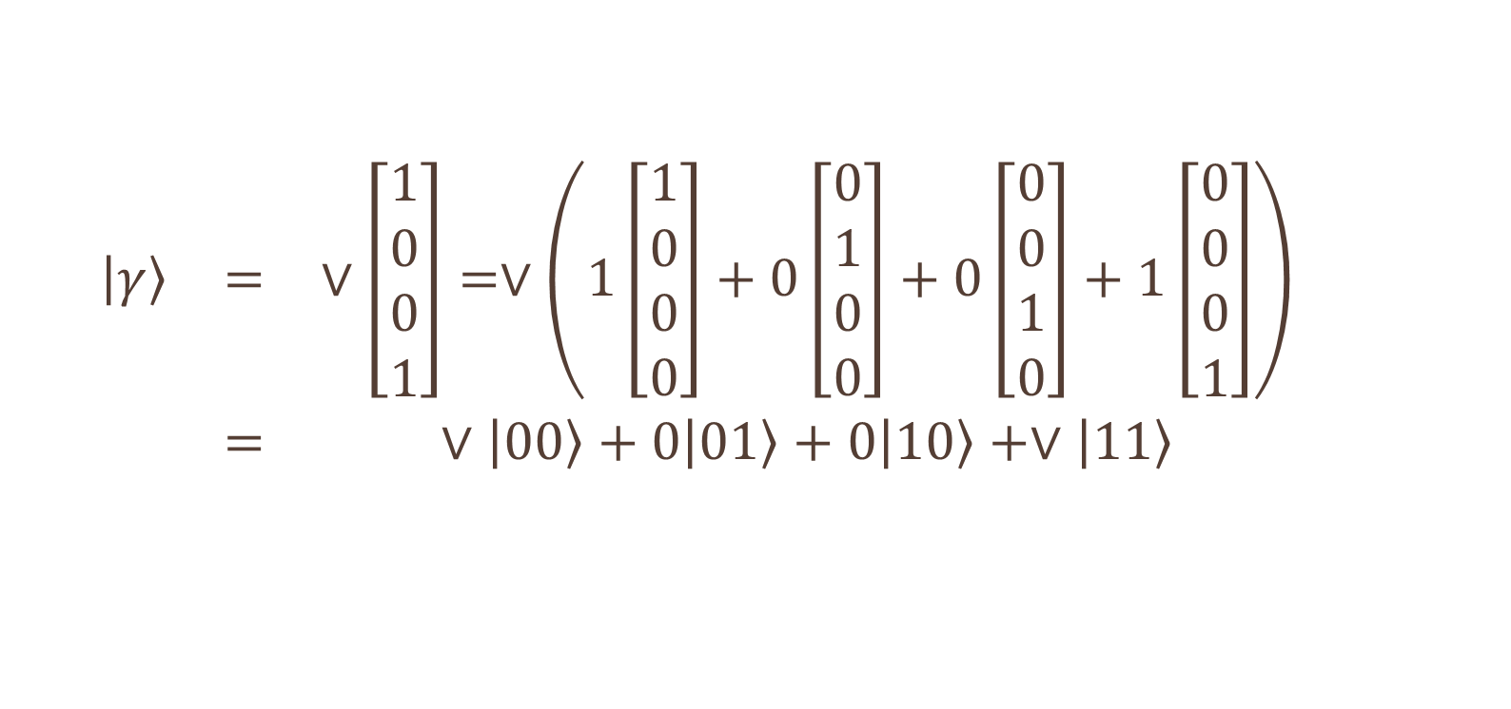
The Value of Gamma
$$\begin{matrix}\begin{matrix}\left|γ\right\rangle & = & ∨\left[\begin{matrix}1 \\ 0 \\ 0 \\ 1\end{matrix}\right]=∨\left(1\left[\begin{matrix}1 \\ 0 \\ 0 \\ 0\end{matrix}\right]+0\left[\begin{matrix}0 \\ 1 \\ 0 \\ 0\end{matrix}\right]+0\left[\begin{matrix}0 \\ 0 \\ 1 \\ 0\end{matrix}\right]+1\left[\begin{matrix}0 \\ 0 \\ 0 \\ 1\end{matrix}\right]\right) \\ & = & ∨\left|00\right\rangle +0\left|01\right\rangle +0\left|10\right\rangle +∨\left|11\right\rangle \end{matrix} & \end{matrix}$$

Slide 13
The Bell States: Perfect Entaglemnt
Bell states are a specific type of entangled state that are maximally entangled, meaning that the information shared between the two qubits is perfectly correlated.
This unique property is crucial for many areas in quantum physics, especially in quantum information science.
In simple terms, if one qubit of a Bell state is measured, the other qubit will immediately show a corresponding result, no matter how far apart they are.
This relationship is what makes Bell states quite fascinating and a key resource for various quantum technologies. The Bell states are a form of entangled and normalized basis vectors, which implies that the overall probability of the particles being in one of the mentioned states is 1.
This entanglement means that the measurement outcomes are correlated, and the state of one particle is dependent on the state of the other particles.
Understanding the relationship between Bell states and entanglement is useful in analysis of quantum communication, such as superdense coding and quantum teleportation. These mechanisms cannot transmit information faster than the speed of light, a result known as the no-communication theorem

Slide 14
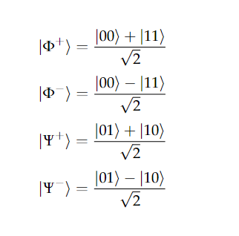
Bell States
Bell states are the four states that can be created when two qubits are maximally entangled. The four states are represented as follows: :

Slide 15
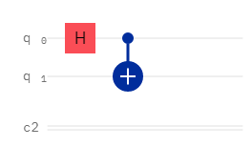
The First Bell State
The first Bell state is incredibly easy to implement as it can be created using a two qubit circuit consisting of a Hadamard gate and CNOT gate found below:

Slide 16
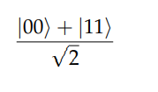
The First
The two qubits will be enabled to this value:

Slide 17
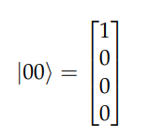
How it works
How it works:. Since the circuit consists of two qubits both initialized to |0〉the initial combined state will be:

Slide 18
Expanding Hadamard (not included)
Now that we have the two qubits initialised we can now apply a Hadamard gate to our control qubit.
However there is a problem. How do we apply a Hadamard gate to our control qubit when it is part of a 2 qubit state?
The best solution is to expand out the Hadamard gates matrix so that we can apply it to our two qubit state.
This can be done by finding the Kronecker product of the Hadamard gate and identity gate.

Slide 19



How it Works?
The Hadamard Gate
The Identity Gate:
The Product:

Slide 20

The Result for Bell One
This leads to the result of the first bell state

Slide 21

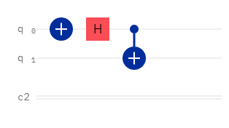
The Second Bell state
Which is the same as the first Bell state but with a negative phase!. As such this can be implemented easily by using the same circuit as the first Bell state but with the addition of initializing the first qubit to |1〉with a Pauli-X gate::

Slide 22

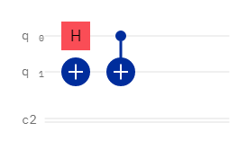
Third Bell State
Same as above, but apply a Pauli x-gate to the second qubits

Slide 23

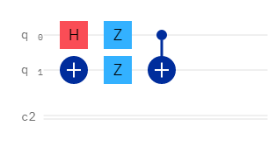
Fourth Bell State
Add Pauli Z gate to both qubits

Slide 24
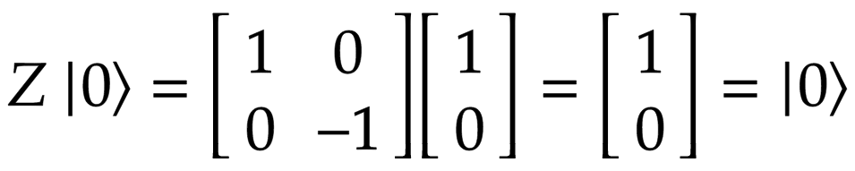
The Z Gate
The Z gate is actually a special case of the phase shift gate where 𝜙 = π = 180°.
It represents a rotation of around the z axis by π radians.
It has no effect on |0〉 but transforms |1〉 to -|1〉.

